Slide 1
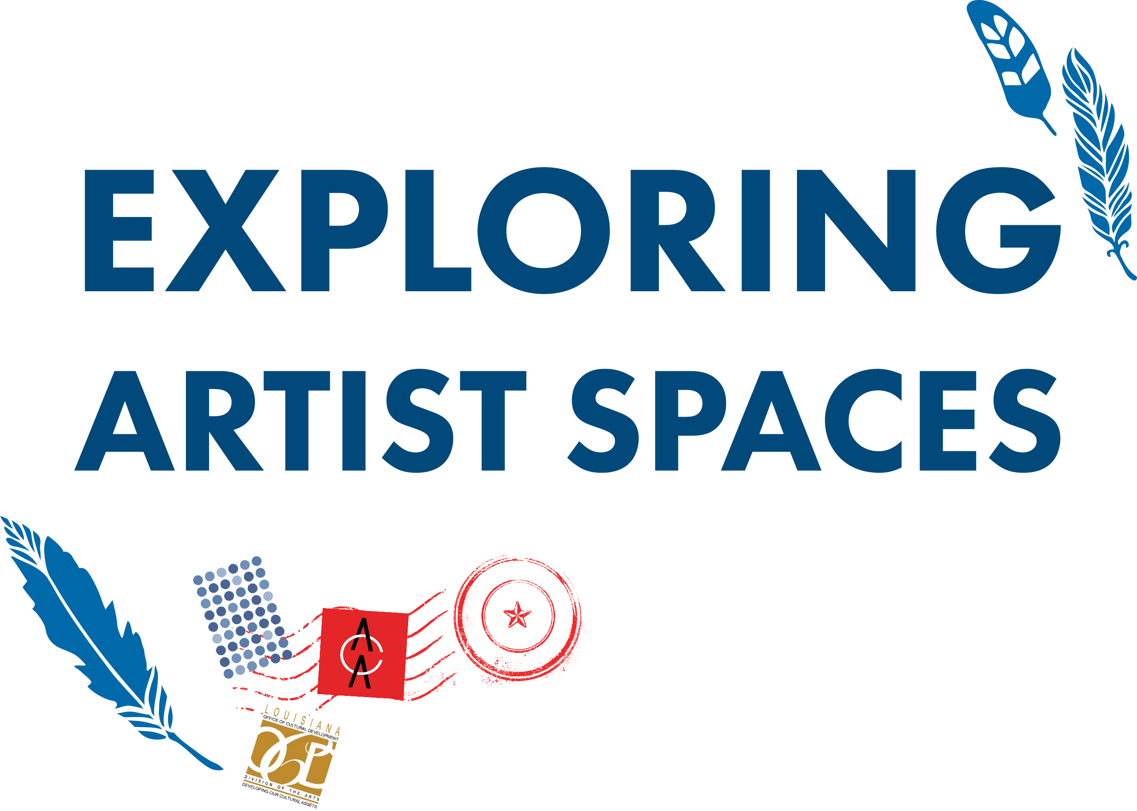

Slide 2
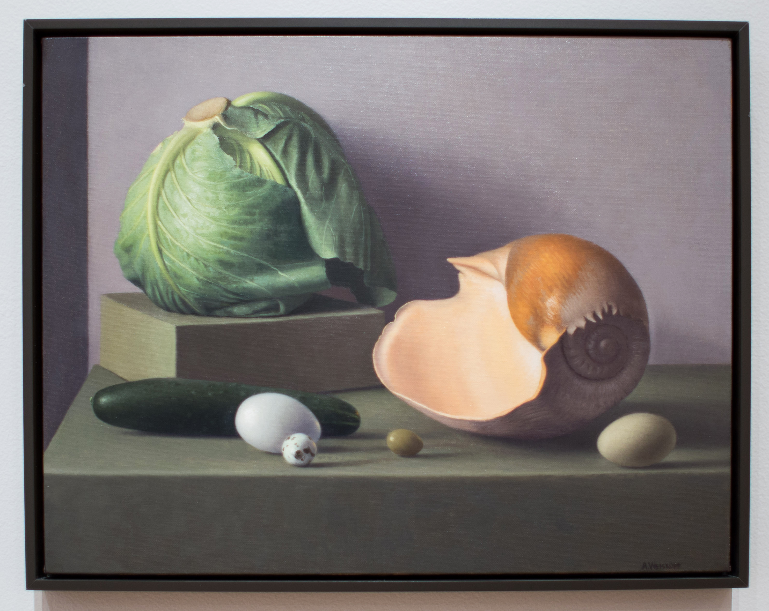
Amy Weiskopf. Still Life with Cabbage and Shell,2014. Oil on canvas

Slide 3
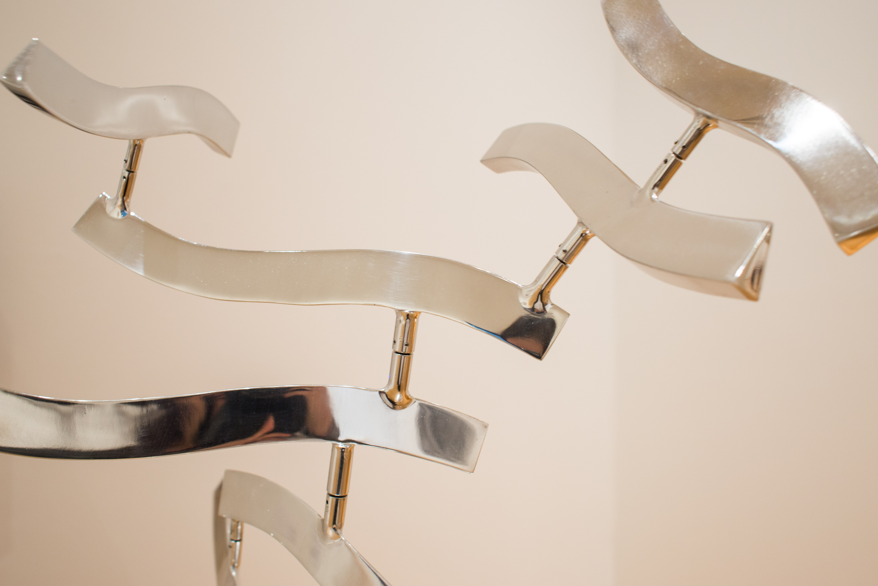
Lin Emery. Anole,2016. Polished aluminum.

Slide 4
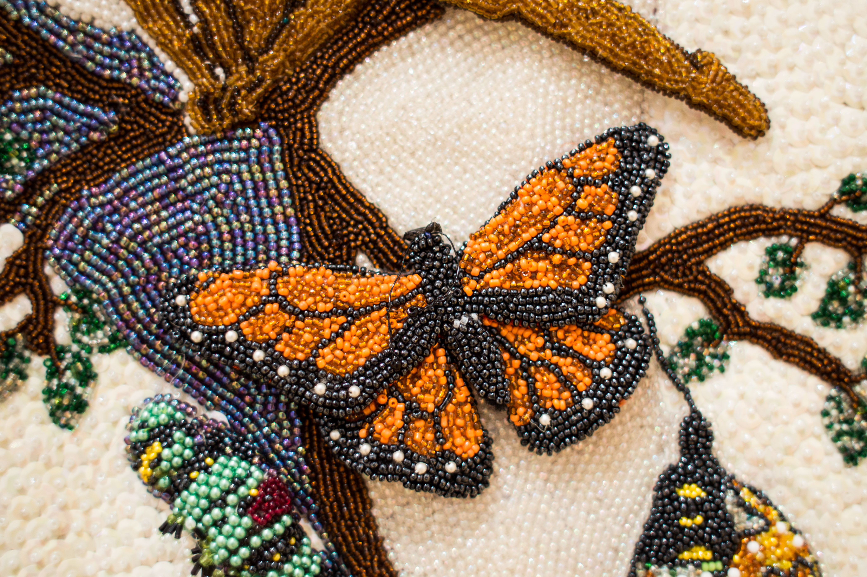
Rukiya Brown. Metamorphosis – The Awakening (detail), 2013. Beads, feathers, acrylic stones, sequins, satin and tiger cowry shells

Slide 5
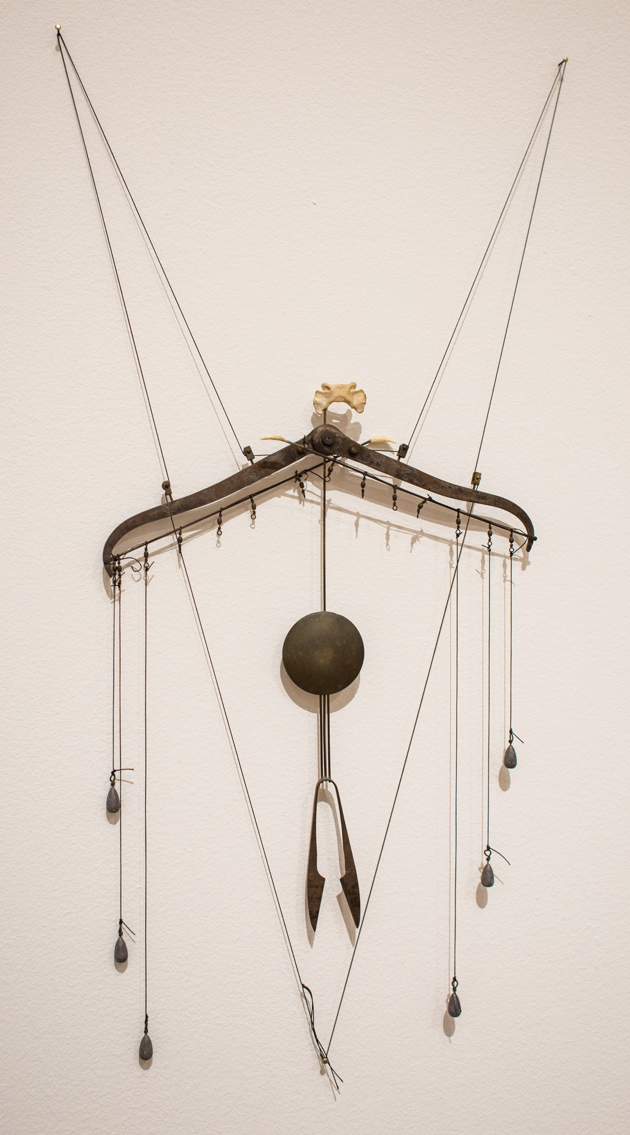
Ersy Schwartz. Bat,1984. String, brass, steel, lead and bone.

